Slide 1
Post Declaration to Constitution

Slide 2
American Revolutionary War
13 Colonies vs. Great Britain
Fought from 1775-1783
America wins
25,000 Americans died during the Revolution
8,000 in battle
17,000 died of sickness/disease or missing in action
9,000 were seriously wounded or injured

Slide 3
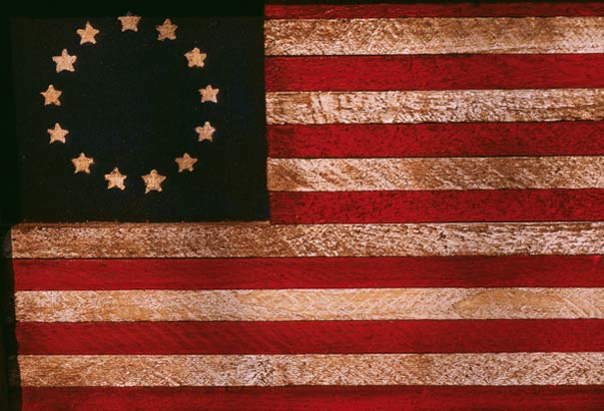

Slide 5
Why Did Britain Lose?
Disinterest on the home front
In Britain there is a disinterest about what was happening across the water
Foreign Intervention
France joins the war on the colonist side
Home field Advantage
The colonist knew the terrain and were able to use it in unconventional or guerilla warfare

Slide 6
Articles of Confederation
The first constitution of the United States
Adopted on November15,1777
Not ratified by all the states until March 1, 1781
It created a loose confederation of states
There was a small, central government with most of the power in the hands of the state government
There was a one house legislature where each state got one vote
A 2/3rds majority was needed to pass any legislation
Unanimous vote was needed to amend articles

Slide 7
Articles of Confederation: Weaknesses
There was no national executive branch
There was no national court system
The national government or the national legislature could not:
Collect taxes
Raise an army
Regulate trade

Slide 8
Articles of Confederation: Problems
States printed their own money so the national currency was worthless
States placed tariffs on each others goods and with the government unable to regulate it there was a huge drop in trade
Foreign countries place tariffs on American goods but federal government could not regulate trade
The government could not raise a navy so American merchants were vulnerable to pirates
The government could not raise an army so the British continued to occupy forts in the Northeast Territory

Slide 9
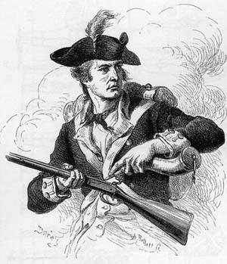
Shays’ Rebellion
Led by farmer and Revolutionary war veteran Daniel Shay
Made up of New England farmers who were desperate to be paid for their service in the Revolutionary War
They attacked the federal arsenal in Springfield, MA
It occurred in January of 1787
Federal troops under Revolutionary war general Benjamin Lincoln came to Boston

Slide 10
Shays’ Rebellion
As a result 4 men were killed and 20 were wounded
Shay fled to the wilderness of what would become Vermont
Men were arrested and soon after the event things were quieted by the election of John Hancock as governor of MA
It showed two things:
The national government was powerless to raise the money or pay back the soldiers because each law could be stopped by one state
The need for a stronger government became more obvious and accepted as necessary

Slide 11
Constitutional Convention
On May 25, 1787 delegates met in Philadelphia State House (now Independence Hall)
Originally the meeting was to revise the Articles of Confederation
The Articles were thrown out and for 3 months they rewrote the document
Washington presided over the convention and Madison took notes
There were many crucial compromises made
It was signed on September 17, 1787

Slide 12
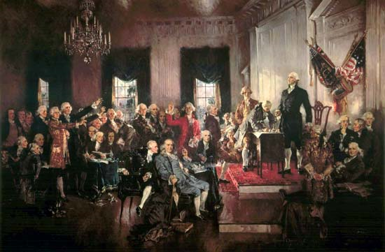

Slide 13
Constitutional Compromises
The Great Compromise
The Three-Fifths Compromise
Bill of Rights

Slide 14
Legislative Representation
Virginia Plan
New Jersey Plan
Wanted the number of representatives to be based off of population
Favored larger states
Was different from the Articles of Confederation
Wanted the number of representatives to be equal for each state
Favored smaller states
Was the same as the Articles where each state had one representative

Slide 15
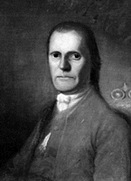
The Great Compromise
Also called the Connecticut Plan
Created by Roger Sherman of Connecticut
There will be a bicameral or two house system
Senate- there will be equal representation for each state
House of Representatives- representation was based off of population

Slide 16
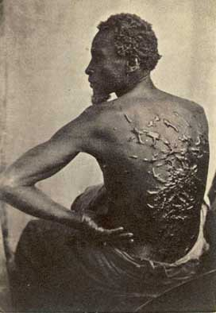
Three-Fifths Compromise
The question became would slaves be included in the counting the population for representatives
Northern States with little slaves did not want slaves counted in the population
Southern states with many slaves wanted them counted as part of the population
The compromise was that slaves would be counted as three-fifths of a person for representatives but also taxes

Slide 17
Bill of Rights
There was concern among delegates that the people were not protected enough
Concern over this Constitution getting completed and into practice caused a compromise
Delegates would support the ratification and after that amendments would be made for a Bill of Rights
Rhode Island was the last to ratify the Constitution in May of 1790
The last Bill of Rights amendment was ratified by December 15, 1791

