Slide 1
Iran
Notes:
Islamic Fundamentalism -
Literal interpretation of the belief should be basis for political ideology.
Transforming of faith into ideology

Slide 2
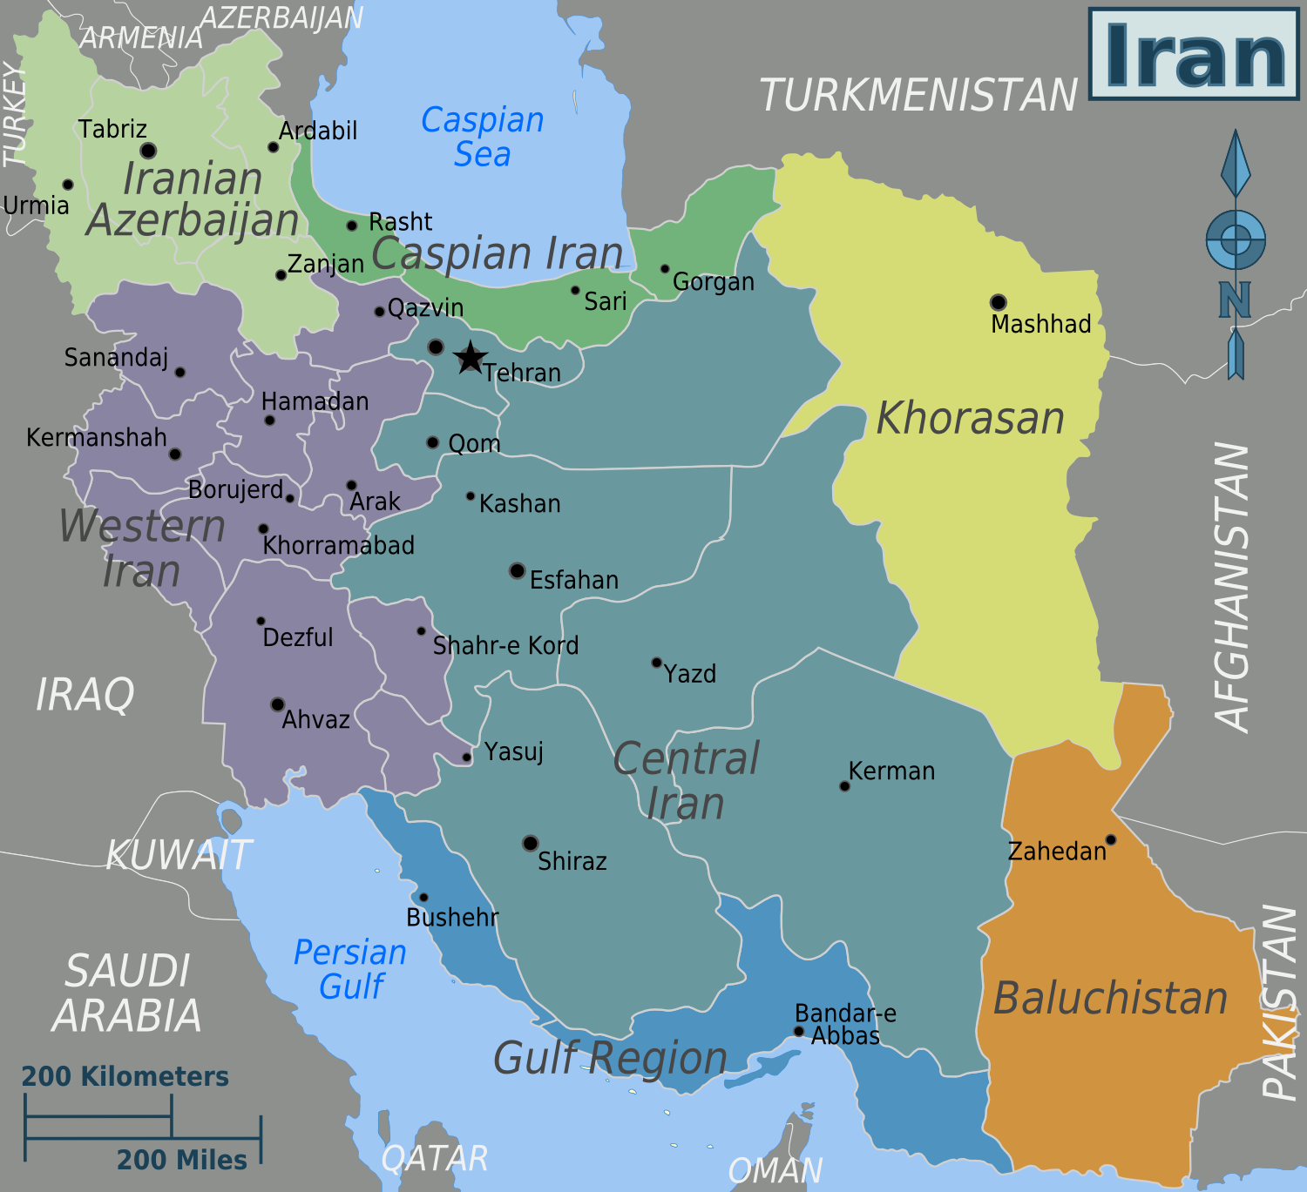

Slide 3
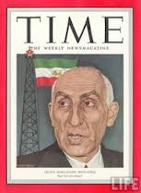
1953 Coup
In 1953, the Shah, with the support of the CIA, overthrew the democratically elected prime minister, Mosaddeq
Notes:
PM Mosaddeq - represented the National Front; favored reducing the power of the monarchy or abolishing it altogether
Wanted national sovereignty and modernization
Wanted to nationalize oil industry (Britain was against this)
Operation Ajax - covert operation to overthrow Mosaddeq and reestablish Muhammad Shah Pahlavi

Slide 4
Pahlavi – “White Revolution”
“White” to counter influence of “red” communists
Land reform – government bought land from large absentee owners and sold it to farmers at affordable prices
Encourage agricultural entrepreneurship with irrigation canals, dams, & tractors
Women’s rights (secularization)
Suffrage
Restricting Polygamy
Women allowed to work outside the home
Notes:
Entrepreneurship meant privatization of some state-run industries.
Both this and women’s rights was opposed by religious leaders.
1963 - rioting against reforms but were violently suppressed (use of SAVAK (secret police)
Shah’s rule
Any democratic pretenses were swept away
Power fell in the hands of the monarch - enforced by military and SAVAK

Slide 5
Pahlavi - OIL & the Rent-seeking state
Iran transformed into a rentier state.
Although the shah promoted import substitution policies, by 1979 oil & associated industries provided 97% of foreign exchange and majority of Iran’s GNP
Oil revenue became so great the government did not have to rely on internal taxes to generate income.
Notes:
A lot of this revenue was used to strengthen the military
Growth of a middle class
Most of the money went the wealthy to support wealthy lifestyle and support the shah.
Created resentment to the West since they directed or ran much of the oil industry. (West plundering the nation)

Slide 6
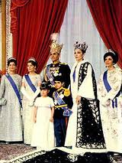
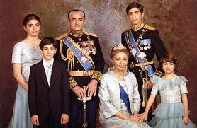

Slide 7
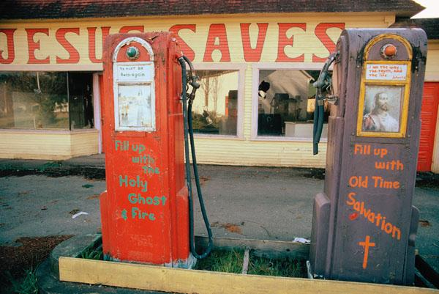
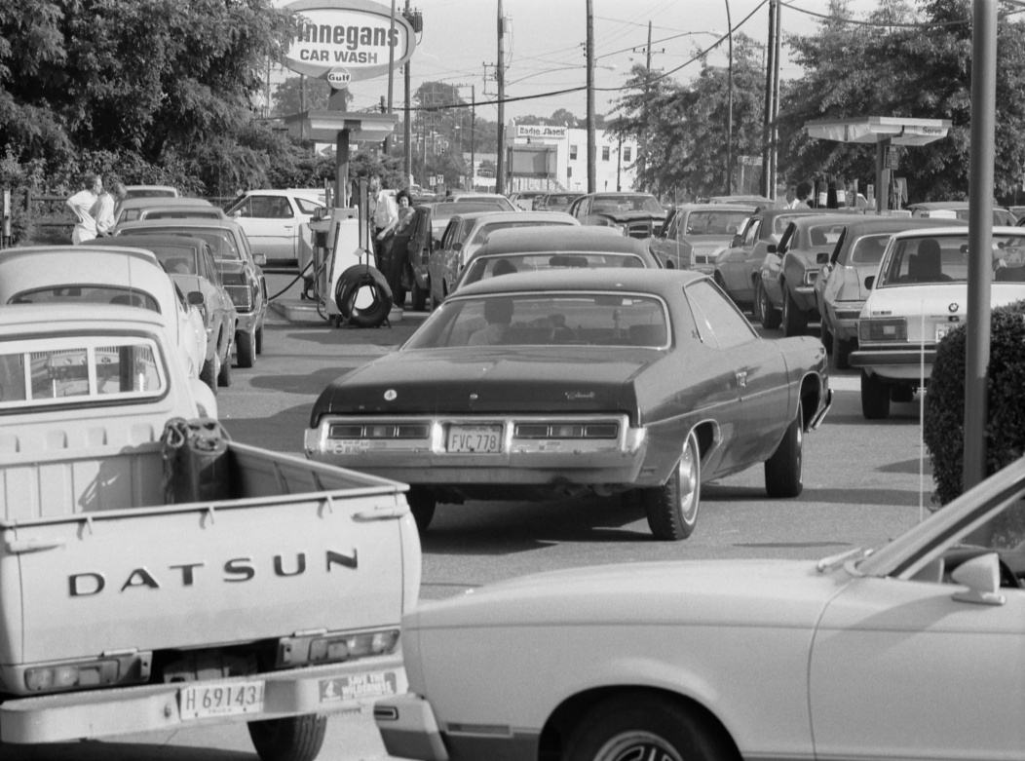
OIL
Abandoned gas pumps
in a U.S. city 1973
Line at gas station in the U.S. 1979
Notes:
POLITICS OF OIL
Yom Kippur/Ramadan/October War
On October 6, 1973 (Yom Kippur), Egypt and Syria attack on Israel. The next day, the Arab state imposed an embargo on oil sales to the United States because of America’s support of Israel.
Iran, which was on good terms with the US. At the time, didn’t join the embargo but used the opportunity to increase its own production and raise oil prices. As a result, Iran was awash with money while Americans waited in lines to buy gas a much-inflated prices.
To balance things out, the Shah spent billions of dollars buying top-of-the line American military equipment and vehicles to supply Iran’s newly expanded armed forces. He also bought eight nuclear power plants to ease Iran’s growing power needs.
The new oil money helped fund a number of government projects but also led to inflation, corruption and a widening gap between the wealthy and the poor who couldn’t buy the luxurious consumer goods that had flooded the market. Popular discontent came to a fever pitch in 1979 when Ayatollah Khomeini returned to Iran vowing to rid the country of foreigners and oust their puppet, Mohammed Reza Shah.
1979 Revolution
In the midst of the chaos of the Islamic Revolution, Iranian oil exports came to a stop. Causing international panic, price controls, rationing and, again, long lines at the gas pumps in the U.S. Iranian oil exports resumed again in March 1979 but the upheaval already caused spikes in gasoline prices and stirred political tensions.
52 Americans were taken hostage by Iranian students in November 1979, American President Carter retaliated by freezing Iranian assets and imposing an embargo on the import of Iranian oil to the U.s. The oil embargo didn’t harm Iran, which simply sold the commodity to other buyers, but it did result in the redistribution of supplies around the world

Slide 8
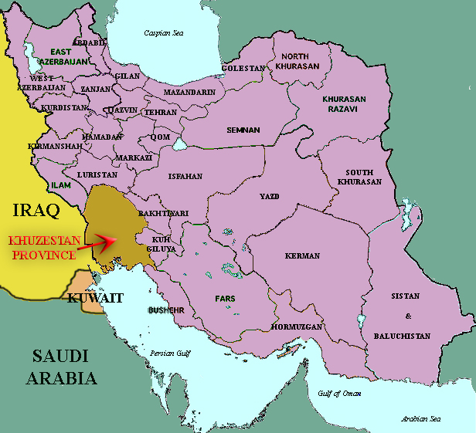
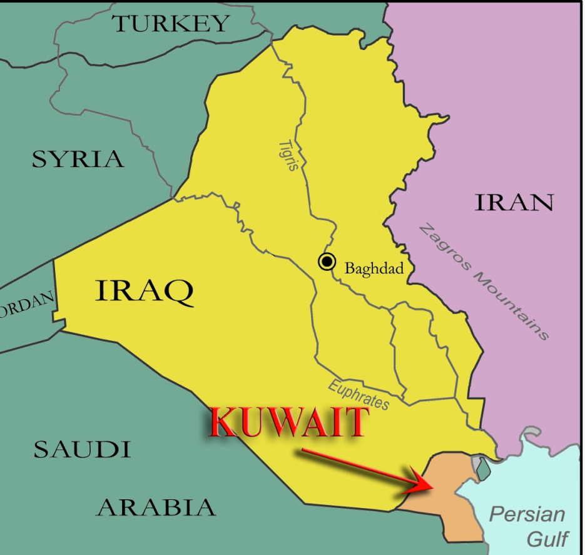
OIL
Khuzestan Province – Iran-Iraq War
1980-1988
Iraq’s Invasion of Kuwait – Gulf War
1991
Notes:
Iran-Iraq War (1980-1988) and Oil
On September 22, 1980, Saddam Hussein declared war on Iran for a number of reasons:
the fear that the Shi’ite Islamic revolution would spread to Iraq’s own Shi’tie majority;
rivalry between Saddam Hussein and Ayatollah Khomeini (who had been expelled from Iraq a few years earlier);
Iran’s support for the Kurds and oil.
The official declaration of war center on control of the Shatt-al Arab waterway, the main shipping route that connects the Iraqi city of Basra to the Persian Gulf and through which most of Iraq’s oil is transported.
The Iraqis also hoped to capture the Iranian province of Khuzestan, home to the main oil-producing cities of Abadan and Masjid-i-Suleiman. Although it was never capture, the city of Abadan was overrun by Iraqis in the first days of the war and sustained great damage to its oil refinery. Production at the oil refinery didn’t resume for another 13 years and only reached its pre-war level of production in 1997. The Iranians counterattacked against Iraqi facilities reducing Iraqi oil exports to only 1.8 million barrels per day (BPD) from 3.2 million barrels before the war. Altogether, the war removed almost 4 million daily barrels of oil from the world market.
Over 1 million dead both Iranian and Iraqi
Shortly after Khomeini dies

Slide 9
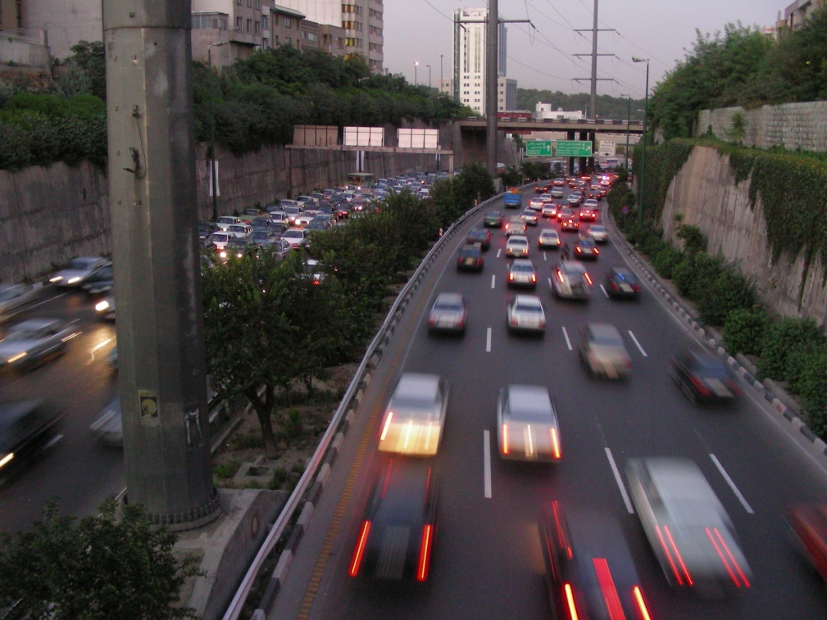
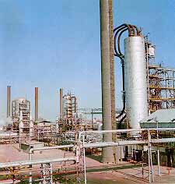
OIL
Highway in Tehran
Oil Refinery in Tehran
Notes:
Iran Today
Takes until 1993 for major oil refinery to be rebuilt and produce pre war levels.
Today, Iran produces almost four million barrels of oil a day, which is still a far cry from the 6-8 million barrels a day it produced in 1974.
Decrease due to Iran/Iraq War and OPEC quotas
To reach production major repairs to refineries and more advanced tech for deeper drilling is needed.
Mismanagement and corruption since foreign managers left Iran in 1979. Article 81 of Iran’s 1980 constitution expressly forbids the “granting of concessions to foreigners” or the “formation of companies or institutions dealing with commerce, industry, agriculture, service, or mineral extraction,” which restricts the participation of foreign companies in Iran’s reconstruction.
American sanctions have also taken their toll by threatening penalties against any nation that invests more than $20 million per year in Iran’s oil industry. The aim was to target Iran’s greatest source of foreign currency thereby hindering Iran’s ability to fund terrorist activity or develop weapons of mass destruction.
Gasoline
Iran is the fourth largest exporter of oil but it is also one of the world’s greatest importers of gasoline. Because it lacks the refining capacity to fully serve its population, Iran is forced to buy 40% of its refined gasoline from outside sources.
Since Iranians became used to paying highly subsidized prices for its gasoline (gas priced at around 35 cents a gallon) the demand rapidly grew.
In June 2007, the government was forced to begin rationing gasoline and raise prices.
Nuclear Energy
Shift - Since oil exports account for more than 80% of Iran’s income earned by exports and provides a steady stream of hard currency( which Iran needs to buy international products), the government has been trying to lessen Iranian consumption of the valuable commodity by employing nuclear power for Iran’s energy needs. Iran is also trying to develop other export products to less reliance on oil for export income.

Slide 10
Khomeini, Fundamentalism, & Revolution
Iranian Revolution—overthrow of the shah
Islamic Revolution—consolidation of clerical power
Resentment towards elites, US, and the Western world
Velayat-e faqih (jurist’s guardianship)
Monarch was a usurption of Allah’s rule on earth
Islamic jurisprudence would be political system established by Muhammad
Notes:
1979 Revolution established Islamic Republic of Iran - violent birth
Suppression of all opposition (monarchists, Marxists, secular political groups, ethnic minorities, other faiths)
1000’s executed in the name of justice
Iran-Hostage Crisis - radical

Slide 12
Khomeini & the Islamic Republic
Clerics consolidate power
Popular support for regime high
World oil prices rise again, allowing for social programs, improvements in medicine & housing
Iraq invades Iran, people rally around the government
Charisma of Khomeini inspired faith in the government
Khomeini dies in 1989, constitution amended
Ali Khamenei succeeds Khomeini
Iran/Iraq war ends in 1988, country war-torn
Oil prices drop in 1990’s
Population may begin to question authoritarian rule of the clerics

Slide 13
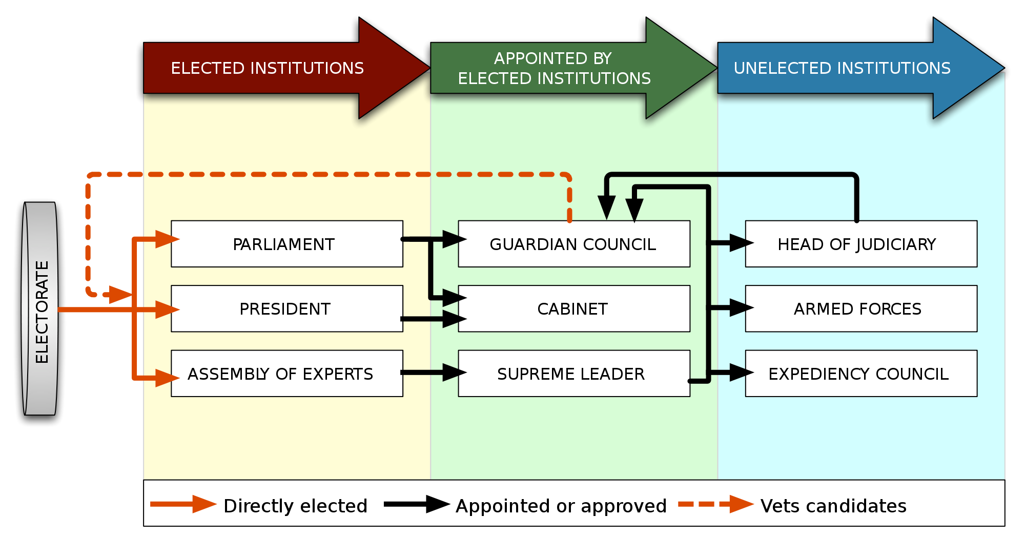
Constitution of 1979
Mixture of theocracy and democracy
Preamble reflects importance of religion
Velayat-e faqih (Jurist’s guardianship)
Gave broad authority to Khomeini and the clerics

Slide 14
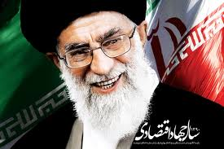
Constitutional Amendments of 1989
Khomeini died in June 1989
The council named Ali Khamenei as Khomeini’s successor and made several amendments to the constitution

Slide 15
Amendments of 1989
They eliminated the need for the Supreme Leader to be a marja, or senior cleric, Khamenei was not a marja
Eliminated the post of Prime Minister
Created the Supreme National Security Council
Increased the size of the Assembly of Religious Experts to 86 members
Gave Assembly of Religious Experts authority to meet once a year & determine if Supreme Leader was “mentally & physically” capable of carrying out their duties
Made the Expediency Council a permanent institution
Constitution amendments approved by Iranian voters in national referendum with 97% yes vote on July 28, 1989

Slide 16
Religion
89% of Iranians are Shi’a Muslims
10% are Sunni Muslim
1% are combination of Jews, Christians, Zoroastrians, and Baha’i
Constitution recognizes rights of religious minorities, many religious minorities have left country since Islamic Revolution
Baha’i leaders have been executed, imprisoned, tortured, their schools closed and property confiscated

Slide 18
Political Culture
Authoritarianism (not totalitarianism)
Union of political & religious authority
Shi’ism & Sharia
Anti-Western sentiment
Nationalism/Influence of Ancient Persia
Notes:
Iranians are Persian NOT Arab country, speak Farsi not Arabic

Slide 20
Women & the Political System
“Equality-with-difference” policy –slants the law favorably towards men on issues such as divorce and custody
Women must wear scarves and long coats in public
Women can not leave country without consent of male relatives
Women can be stoned for committing adultery
Women are allowed to get education in Iran and entrance into some occupations
Expectations for better jobs and increased political rights among educated women
Half of college students in Iran are women
Women make up 27% of the labor force

Slide 22
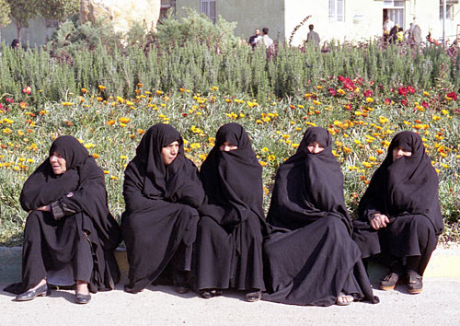
WOMEN IN IRAN
Notes:
Pictures
Top row: girls singing in car (Shiraz), girls in Isfahan, sign for WC (notice woman with headcovering)
Bottom row: segregated bus (Tehran), women wearing chadors (Tehran), Iran Air stewardess in uniform.
Thirty-one female activists were arrested in Tehran in March 2007 after gathering outside Tehran's Revolutionary Court. The women were there in support of five fellow activists who had demanded changes in laws discriminating against women.
Among the grievances:
1) Iran has laws on the books that permit death by stoning for women accused of adultery.
2) In accordance with Islamic law, women are entitled to receive only half the inheritance that men receive.
3) Family laws deny women full custody of their children after a divorce.
4) Iranian men are permitted to marry up to four wives in accordance with Islamic custom.
5) Employment laws in Iran discriminate against women.
6) Women are required to dress modestly by covering their hair with headscarves and donning loose- fitting coats called manteaus. (Some women choose to wear the more modest head-to-toe black or gray chador, as do those women who work in government jobs).
7) Women must sit in separate sections on local buses and may only eat in “family sections” in some restaurants.
8) Women cannot become judges.
9) A woman’s testimony is worth only half that of a man’s.
10) Women are required to have a male guardian’s permission to work or travel.
11) Unmarried, unrelated men and women are not permitted to congregate without chaperones.
12) Women are not allowed to sing in public.
Dress codes had loosened considerably since they were imposed after the 1979 Islamic Revolution – especially as a result of the liberalization of Iran during the term of reformist President Mohammed Khatami from 1997-2005.
Iran's President Mahmoud Ahmadinejad tried to reverse the trend by cracking down on “improperly” attired men and women. He has used threats by the U.S. as a pretext to curb dissent by claiming that Iran's enemies are using women's and students' movements to foment discontent and discredit the government.
Aside from the discriminatory restrictions stated above, women in Iran enjoy many rights not exercised by women in other Muslim countries. More than ½ of all Iranian university students are women. Women are represented in the parliament and may run for high offices (including the presidency). Women are allowed to work, drive and participate in public events.

Slide 23
Political Parties
Conservative Alliance—there are several parties on the right that fall within this group.
Reformist Coalition—the collection of parties on the left.

Slide 24
Elections
Citizens over 15 allowed to vote until 2007
In 2007, the voting age was changed to 18
National elections are held for the following:
Assembly of Religious Experts
Majlis (Parliament)
President
Elections to Majlis and President are by plurality, winner-take all
Presidential elections are done over two rounds
First round narrows field down to 2 candidates
Majli and Assembly elections are SMD and MMD in some districts

Slide 25
Iranian Presidential Election - 2009
Only 4 candidates out of 476 men & women who applied were approved by Guardian Council
In a June election, Mahmoud Ahmadinejad ran against three challengers
Turnout was unexpectedly high, well over 50% and polls had to be kept open until midnight
Ahmadinejad was announced as the winner the next morning with 62% of vote to Mousavi’s 34%
Protest immediately erupted (the Green Revolution) in favor of Mousavi and claiming election fraud

Slide 26
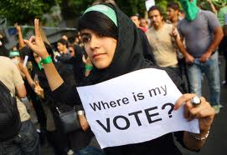
Election of 2009

Slide 28
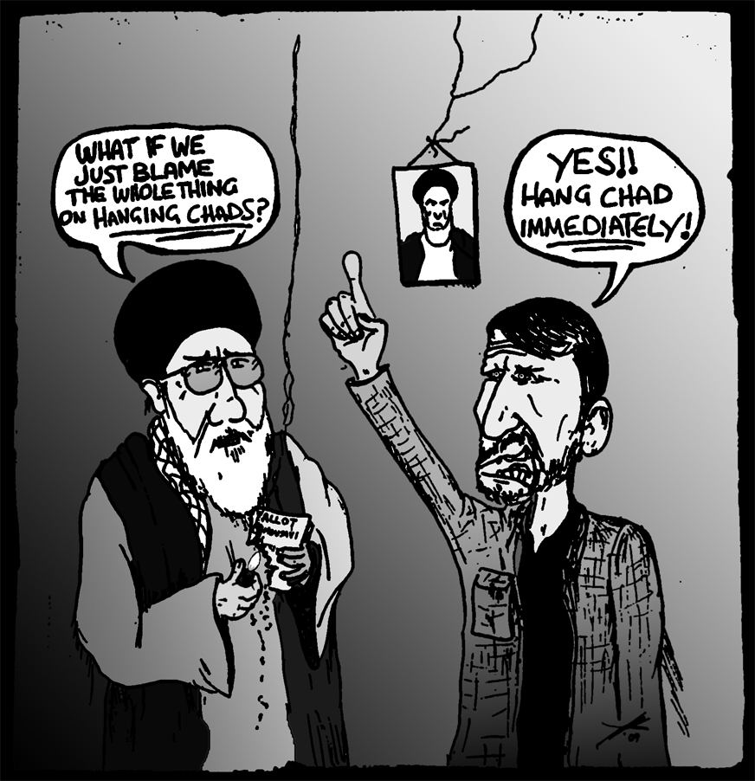

Slide 29
Iranian Presidential Election 2009
June 14, Mousavi files formal appeal of results with Guardian Council
June 15, Supreme Leader Khamenei announces investigation of electoral results
June 16, Guardian Council announces it will recount votes, however, Mousavi states that 14 million ballots were missing, allowing for a chance to manipulate the results
June 29, Iran’s electoral board completes partial recount, and concludes that Ahmadinejad won the election – this leads to more protests

Slide 30
2013 Presidential Election
The Guardian Council screened 680 candidates, and 8 were allowed to run
Hassan Rouhani won in the first round with 50.88% of the vote.
Voter turnout was 73%
Rouhani is from the Moderation and Development Party, a centrist party

Slide 31
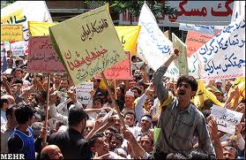
Interest Groups
Islamic Association of Women
Green Coalition
Workers’ House
Holds a May Day rally every year, which turned into protest in 1999 against conservative policies to weaken labor laws

Slide 32
Velayat-e faqih (Jurist’s guardianship)
The principle instituted by Khomeini of overarching authority for different government institutions:
Supreme Leader
Guardian Council
Assembly of Religious Experts
Expediency Council
Clerics rule consistent with Islam and as champions of the people

Slide 33
Supreme Leader
Formal Powers of Supreme Leader:
Elimination of presidential candidates
Command armed forces
Declare war & peace
Appoint Chief Justice
Nominate six members of Guardian Council
Appoint many non-governmental directors, such as radio/TV and semi-public foundations
Informal Responsibilities as Religious Leader:
faqih – he is the leading Islamic jurist to interpret shari’a and religious documents
Links three branches of government together
“Determining the interests of Islam”

Slide 34
GRAND AYATOLLAH ALI KHAMENEI
(Supreme Leader 1989-present)
Notes:
KHAMENEI ASCENDS
By 1988 Khomeini was 88 years old and his health was declining. He knew that it was time to prepare the country for his successor and was aware that no candidates could match his charisma and authority and religious credentials. To preemptively strengthen his successor’s position, therefore, Khomeini proclaimed that the authority of the Supreme Leader (Vali-ye faqih) was absolute.
Khomeini had first designated Grand Ayatollah Hossein-Ali Montazeri to be his successor. Montazeri’s criticism of Khomeini and the hardliners in the Islamic government and his denouncement of the institution of Velayat-e faqih, though, made him an unsuitable candidate. Instead, Seyyed Ali Hosseini Khamenei, Iran’s president since 1981 and a close confidante of Khomeini, was chosen. Khamenei was a high-ranking cleric but, unlike Montazeri, he hadn’t yet reached the rank of Grand Ayatollah which, at the time, was a constitutional requirement to fill the post of Supreme Leader.
To accommodate Khamenei, Iran’s constitution was changed to allow someone of a lower clerical rank to be elected leader of the Islamic Republic of Iran. He was later promoted to the appropriate rank though some Shi’ite clerics refused to acknowledge Khamenei’s new clerical position contending that the rank of Grand Ayatollah must be earned.
Two days after Khomenei’s death on June 3, 1989, the Assembly of Experts announced that Khamenei would be Iran’s new Supreme Leader.
To counter any questions about his legitimacy serving as Iran’s highest leader, Khamenei radically adhered to Khomeini’s ideological principles. By assuming a conservative stance on issues pertaining to the Islamic Republic, Khamenei also earned the support of conservative clerics who controlled most of Iran’s governmental institutions.

Slide 35
Guardian Council
12 members
All Male
6 members (clerics) appointed by Supreme Leader
6 members (lawyers) nominated by chief judge, approved by Majlis
Serve 6-year terms
Responsibilities
They represent theocratic principles within the government
Review bills passed by Majlis to ensure they conform with shari’a (revision if necessary)
Guardian Council and Supreme Leader together exercise principle of jurist’s guardianship (Make sure all democratic bodies adhere to Islamic laws & beliefs)
Power to decide who can compete in elections

Slide 37
Assembly of Religious Experts
Expanded in 1989 to 86 members
Directly elected by the people
8 year terms
A 1998 revision now allows non-clerics to stand for Assembly – candidates are still subject to approval by Council of Guardians
Responsibilities
Broad constitutional interpretation
Elected Khomeini’s successor (Khamenei)
Reserve right to remove Supreme Leader

Slide 38
Expediency Council
Referees disputes between the Guardian Council and the Majlis
Final decision cannot be overturned
Currently consists of 40 permanent members
It may originate its own legislation
Not all members are clerics
Appointed by Supreme Leader for five-year terms
Collectively most powerful men in Iran
Currently headed by Akbar Hashemi Rafsanjani (former Pres and rival of Khamenei)

Slide 39
President & the Cabinet
The president does not have the same authority as presidents in presidential systems such as U.S., Mexico, and Nigeria
The president is the highest official representing democratic principles in Iran
Directly elected every 4 years for a maximum of two terms
Constitution still requires the president to be a Shi’ite and uphold Islamic principles
Need not be a cleric

Slide 40
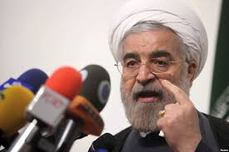
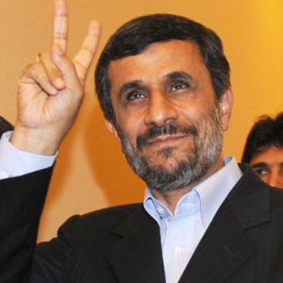
Hassan Rouhani
Ahmadinejad
President 2005 - 2013
President 2013-present
Notes:
AHMADINEJAD
Before becoming president, Ahmadinejad was a resolute supporter of the Islamic Revolution and headed a hard-line student group while obtaining his degree in engineering. Several of the 52 hostages held at the American Embassy in 1979 claimed that he was one of their captors though the charges were fervently denied by Iranians who participated in the hostage crisis.
In 2003, though a relative unknown, Ahmadinejad became the mayor of Tehran. As mayor, he reversed many of the reforms enacted by previous moderate mayors.
In August 2005, Ahmadinejad won the presidential election based on his platform to combat corruption and distribute oil revenues to the people among other populist reforms.
He also supported a religiously conservative agenda. As president, Ahmadinejad banned many imported films and barred all Western music from state radio and TV stations. In 2007, his administration cracked down on un-Islamic behavior by fining and/or detaining Iranians deemed to be “improperly” attired. And much to the dismay of international civil rights groups, Iran’s President also closed liberal newspapers, blocked web sites and came down on independent journalists and bloggers.
Ahmadinejad made international headlines when he claimed that accounts of the Holocaust were fabricated in order to provide the pretext for the creation Jewish state and called for Israel to be “wiped off the map.”
Most disturbing to the West was Ahmadinejad’s defiant stance on Iran’s right to complete the “nuclear cycle” to create nuclear energy on Iranian soil – although he consistently claimed that the program was for peaceful purposes only.
He was won praise from Muslims worldwide for his bold stand against the West, his support for Palestinians and his dogged pursuit of nuclear energy.
Internally, Iranians have feared that his focus on international issues and Iran’s nuclear program have diverted attention away from domestic problems: Iran’s high inflation rate, unemployment and housing shortages. Others worried that his defiance of the U.N. would lead ever more stringent sanctions or war.

Slide 41
President’s Power
Devising the Budget
Supervising economic matters
Proposing legislation to the Majlis
Executing policies
Signing of treaties, laws, and agreements
Chairing the National Security Council
Selecting deputies and cabinet ministers
Appointing provincial governors, town mayors, and ambassadors

Slide 42
Semipublic Institutions
Usually called “foundations” (bonyads), an Islamic charity organization
Foundation of the Oppressed
Martyrs Foundation
Foundation for the Publication of Imam Khomeini’s Works
Tax exempt
Have a great deal of wealth
Most property they supervise was confiscated from pre-1979 elite

Slide 43
Legislature: MAJLIS
Unicameral legislature
290 seats
30 yr old
4 years terms
All directly elected through single member districts by citizens over 18 years old

Slide 45
Majlis Authority
Powers of the Majlis
Enacting or Changing Laws, qanun (with approval of Guardian Council)
Interpretation of legislation (as long as it does not contradict judicial authorities)
Appointment of 6 of 12 Guardian Council members from a list made by chief judge
Investigation of the cabinet ministers and public complaints against the executive and judiciary
Removal of cabinet ministers, but not the president
Approval of budget, cabinet appointments, treaties

Slide 46
2012 Majlis Elections
A third of the candidates were disqualified
Khamenei’s supporters won a large majority of seats, showing support for clerical rule
The conservatives, led by Ahmadinejad’s party, became the minority party in the legislature.
Voter turnout was high.

Slide 47
Judiciary
Distinction between two types of law: sharia & qanun
Headed by chief justice - appointed by SL for five-years (cleric)
No judicial review
Principle of jurist’s guardianship means that the Supreme Leader, the Guardian Council, and the Assembly of Religious Experts have final say regarding interpretation of law
Because interpreting shari’a is difficult it has been applied in different ways at various times

Slide 49
Law & Justice
Khomeini realized that despite the influence of sharia judges, the regime did need a centralized judicial system to tend to matters of justice in an orderly manner
Modern methods of punishment are more common than harsh public retribution
High Execution rate (2nd to China)
Regime retained the shah’s court structure
Appeals system
Hierarchy of state courts
Revolutionary Court (moharebeh)
Central government’s right to appoint and dismiss judges
Notes:
Moharebeh - “rebellion against God”

Slide 50
Military
Revolutionary Guard – “corps of the faithful” was established by Khomeini after the revolution as an elite military force
Commanders of the Revolutionary Guard are appointed by the Supreme Leader
According to the constitution, the regular army defends the borders, the Revolutionary Guard protects the republic
Basij – volunteer militia created during Iran-Iraq War. Grassroots civil defense force
Currently serve as the Islamic Republic’s “morality police”
Iran’s armed forces currently have over 545000 active troops making it the 23th largest army in the world

Slide 52
Theocratic & Democratic Elements of Iran’s Government Structure
Structure Supreme Leader | Theocratic Characteristics Jurist guardianship; ultimate interpreter of shari’a; appointed for life | Democratic Characteristics Can be removed by religious experts
Guardian Council | Jurist guardianship; interpreter of shari’a; six members selected by the Supreme Leader | Six members selected by the Majlis; which is popularly elected, indirect democratic tie
Assembly of Religious Experts | Jurist guardianship; interpreter of shari’a | Directly elected by the people

Slide 53
Theocratic & Democratic Elements of Iran’s Government Structure
Structure Expediency Council | Theocratic Characteristics Appointed by the Supreme Leader; most members are clerics | Democratic Characteristics Some members are not clerics
Majlis | Responsibility to uphold shari’a | Directly elected by the people; pass non religious laws
Judiciary | Courts held to shari’a law; subject to the judicial judgments of the Supreme Leader, Guardian Council | Court structure similar to those in democracies; “modern” penalties, such as fines and imprisonment

Slide 54
Public Policy: Policy-Making Factions
Conservatives
uphold principles of regime established in 1979
Wary of modernization because it threatens Shi’ism
Wary of western influence
Political & religious decisions should be one in the same
Reformists
Believe political system needs reform (but disagree on what reforms)
Advocate some degree of international involvement with western countries
Believe Islam is an important basis of Iranian society
Support the idea that political leaders do not have to be clerics

Slide 55
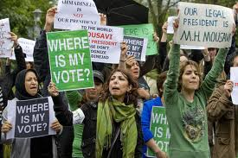

Slide 56
Public Policy: Policy-Making Factions
Statists
Government should take active role in the economy
Policy goals include:
Redistribute land
Redistribute wealth
Eliminate unemployment
Finance Social Welfare Programs
Price restrictions on Consumer goods
Free-marketers
Similar market principles to the US, but in a theocratic/democratic state
Liberal Economic Policies
Remove price controls
Lower business taxes
Encourage private enterprise
Balance the budget

Slide 57
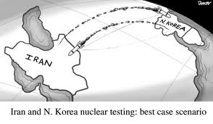
NUCLEAR WEAPONS

Slide 58
NUCLEAR POWER: Peaceful or Aggressive Intentions?
Energy
Demand for energy outpacing supply
Reserve oil for export
Technical developments
Permitted according to terms of the NPT
Weapons
Iran has enough natural gas
Aggressive rhetoric of Iran’s former President, Ahmadinejad
Secret construction of nuclear power plants
Notes:
NUCLEAR POWER: PEACEFUL OR AGGRESSIVE AIMS?
Ayatollah Khomeini’s successors continue to maintain that Iran is only interested in developing nuclear power with no intention of building weapons. In 2005, Supreme Leader Ayatollah Ali Khamenei even issued a fatwa (a legal ruling by an Islamic cleric) forbidding the production, stockpiling and use of nuclear weapons.
Critics abroad doubt this claim and contend that Iran has more than enough natural gas to make hundreds of megawatts of electricity each year. They claim that Iran’s government is using the need for nuclear energy as a cover to develop nuclear weapons and point to Iran’s secret development of nuclear power plants as evidence that Iran has had nefarious intentions.
Iranian officials point out that under the terms of the Non-Proliferation Treaty or NPT (Article IV in particular), which Iran joined in 1974, Iran has the legal right to develop its nuclear power program and is even entitled to receive help from other nuclear-powered nations. But because of sanctions, they contend, Iran was forced to acquire parts and expertise from underground sources.
Iranians have asserted that the rate of Iran’s growing demand for energy is rapidly outpacing the country’s ability to produce it. Without exploring alternative sources of energy, officials have predicted the country will have to import oil by the year 2021– a disastrous fate for a country that obtains 80% of its export earnings from oil. Already, Iran is forced to import refined oil products from regional countries since domestic refineries can only produce about 60% of the gasoline Iranians consume daily.
Relying on nuclear energy for Iran’s power needs would also allow the country to sell the surplus oil that it currently burns to generate electricity.

Slide 59
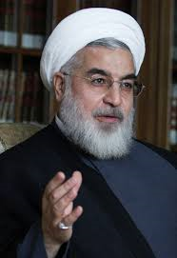
FUTURE
Iran’s government may be losing legitimacy
Iranians are Muslim, support religious rule.
Tension with the West may be easing
Notes:
FUTURE
Representatives of the European Union have optimistically said that the door is still open for negotiation with Iran. Many members of the U.S. Administration, on the other hand, think aggressive action is needed against the country. Many American politicians, including President George W. Bush, Vice President Dick Cheney and even leading 2008 Democratic presidential candidates Barack Obama and Hillary Clinton have said that "all options are on the table" if Iran continues to defy international pressure and becomes hostile.
The greatest fear among Americans, Israelis and other nations, is that Iran will acquire nuclear weapons and dramatically alter the geopolitical balance in the region. A nuclear-armed Iran would be a great military threat to Israel and could threaten Europe and the U.S. if the Islamic Republic acquired missiles with long-range capabilities. A nuclear-armed Iran could also trigger an arms race throughout the Middle East as Sunni-Muslim countries (Saudi Arabia, Jordan, Egypt) developed their own nuclear-weapons programs in defense and to offset Iran's new military power. Conversely, a nuclear-armed Iran could be an asset to Muslim countries if they joined together against the West.
Since Iran is one of the biggest supporters of militant Islamic organizations (including Islamic Jihad, Hezbollah, Hamas and possibly insurgents in Iraq and the Taliban), there is also real fear that these groups or other terrorists would get their hands on nuclear weapons and wield terrible destruction.
Even without possessing nuclear weapons, Iran has used its nuclear program and the implied threat of nuclear war as a bargaining chip to gain concessions from the West. If the leaders changed course and proclaimed intent to develop nuclear weapons, the United States and Europe would be forced to engage diplomatically with Iran.
This danger is so significant that Israelis and many Americans have urged the U.S. government to preemptively strike Iran's nuclear facilities, as Israel did in 1981 when they destroyed Iraq's Osirak nuclear reactor, setting back Iraq's nuclear weapons program for years.
Alternatively, the U.S. has covertly supported resistance groups within Iran, in the United States and abroad. A more passive approach towards Iran has been suggested by the Iraq Study Group headed by former U.S. Secretary of State James Baker and former Congressman Lee Hamilton. The group suggested engaging Iran constructively in order to help end the violent impasse in Iraq. An even bolder and controversial suggestion came from IAEA chief Mohammed ElBaradei. In his estimation, since Iran has already attained the know-how to enrich uranium, the world should simply get used to dealing with a nuclear Iran

